Slide 1
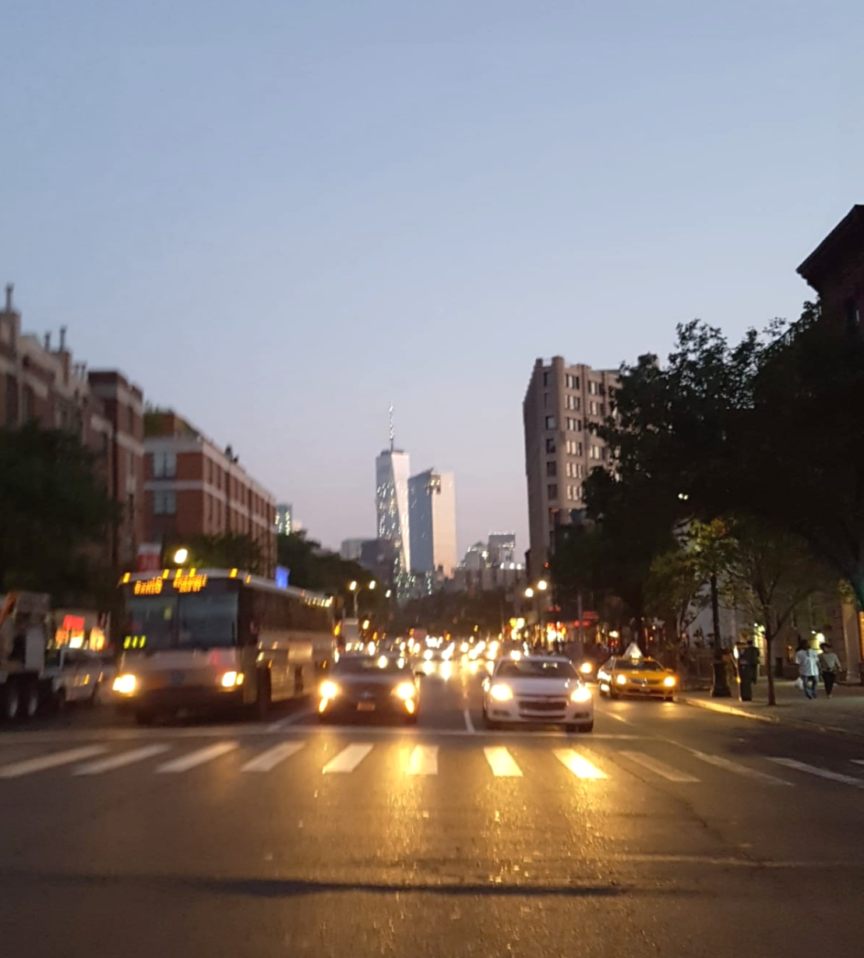
Using Predictive Analytics to
Uncover Traffic Safety Insights
Knight Rider Capstone Project
NYU Master of Science, Business Analytics
Advisor: Panos Ipeirotis
Class of 2019

Slide 2
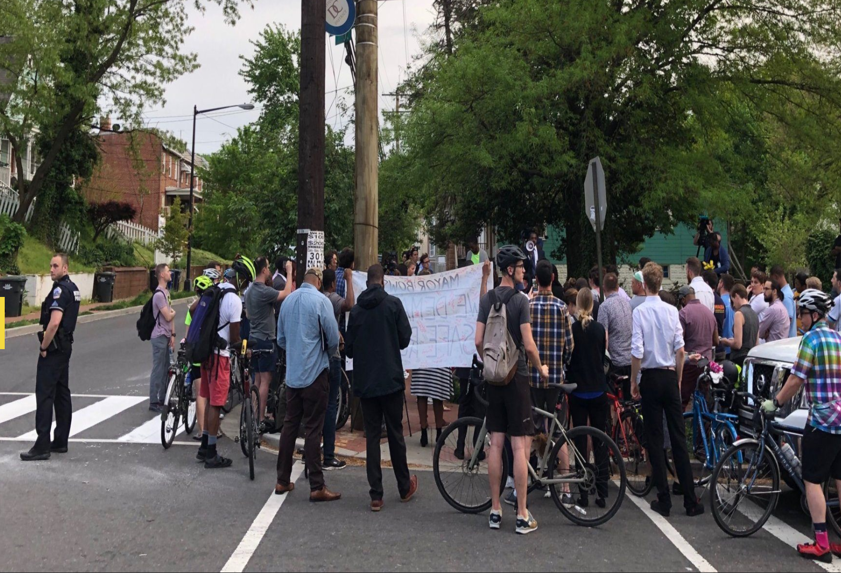
April 24, 2019
V St & 16th St SE Washington, D.C.

Slide 3
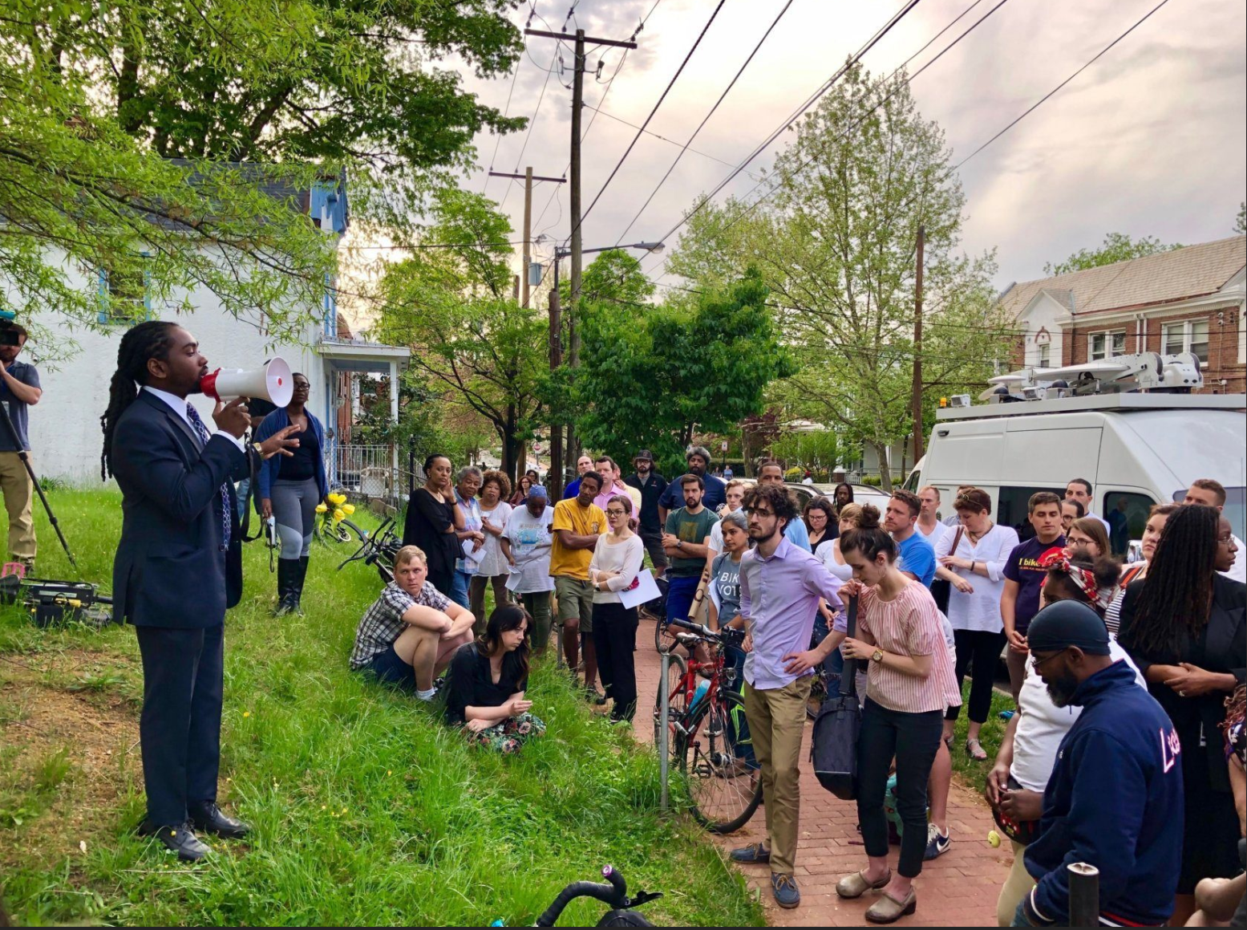

Slide 4
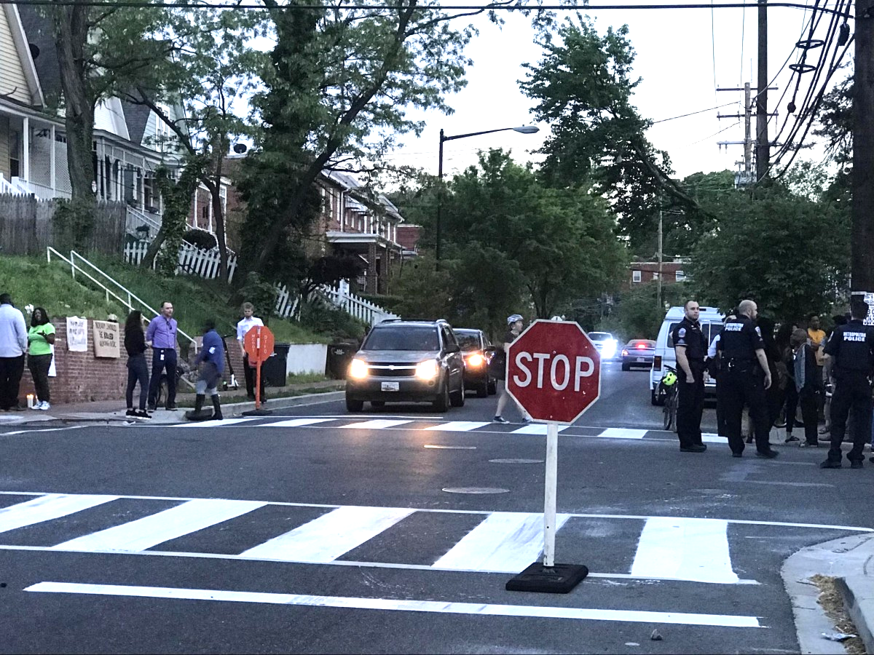

Slide 5

A fundamentally different approach to traffic safety
Traffic deaths are preventable
Reduce severity of crashes
Data-driven systems approach

Slide 6
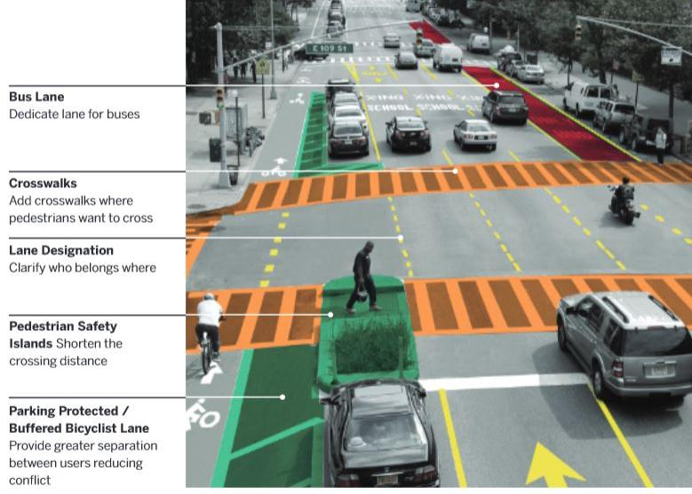

Slide 7









Slide 8
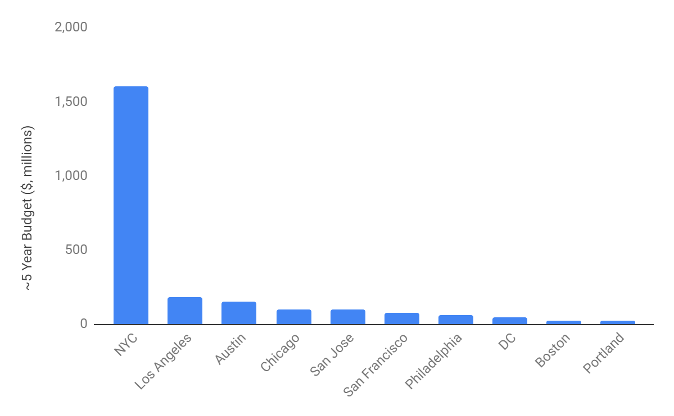
5-Year Budget for Vision Zero by City
$1.6 billion
$, millions

Slide 9
Primary Objective
Where does a city new to Vision Zero allocate resources?
Secondary Objective
How can Vision Zero cities better learn from each other?

Slide 10
Primary Objective
Where does a city new to Vision Zero allocate resources?
Secondary Objective
How can Vision Zero cities better learn from each other?

Slide 11
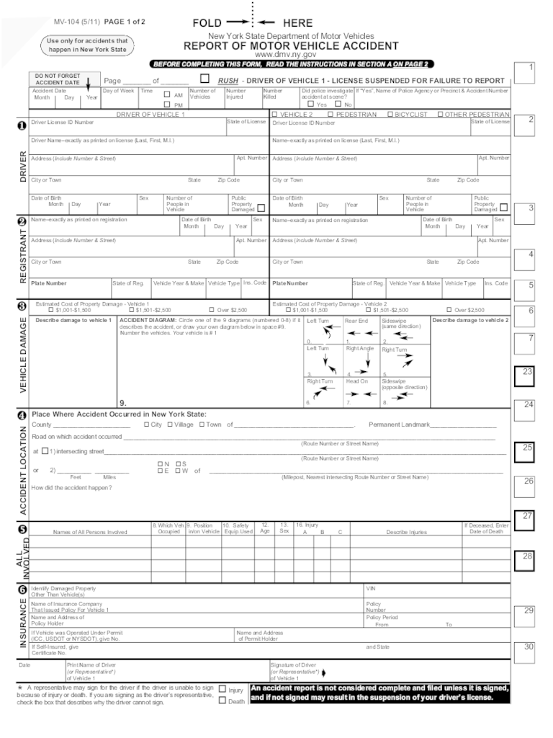
Barriers to Effective Traffic Interventions
Limited budgets
Time / resource intensive
Data quality issues
Reactive approach

Slide 12
How can cities that have robust collision data (NYC, LA, DC) help cities that are relatively newer to Vision Zero?

Slide 13
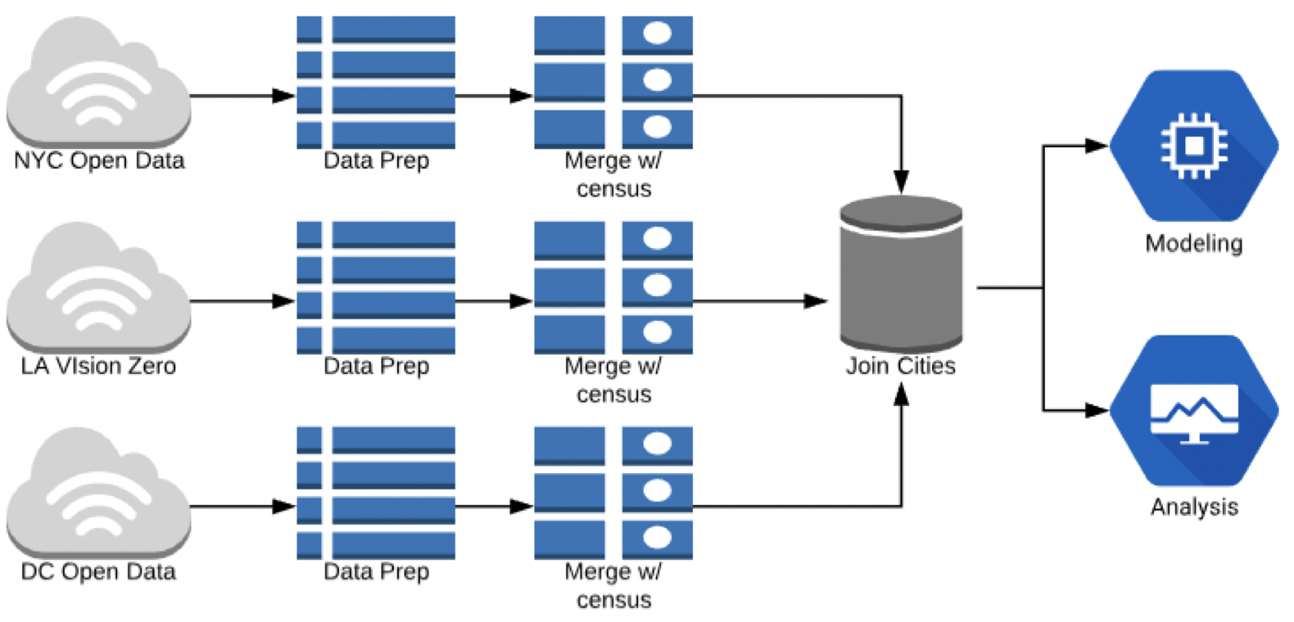
For three U.S. cities, we merged collision data with Census data
(and road data in NYC)

Slide 14
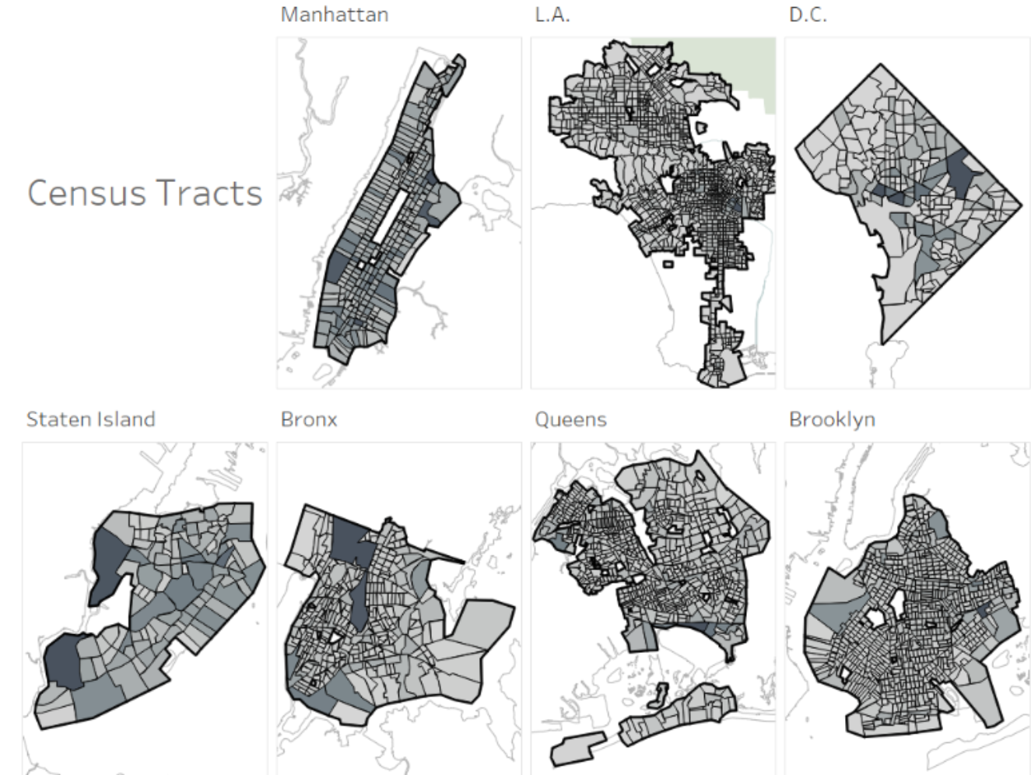
We aggregate collision, Census, and road data at a hyperlocal level

Slide 15
26 feature variables, available in each Census Tract
Census Data
(American Community Survey, 2013 - 2017)
Road Characteristics, NYC Only
(NY Roadway Inventory data, 2013 - 2017)
Population Density
Race
Gender
Age
Marital Status
Median Earnings
Modes of Transportation
Education
Mean Speed Limit
Average Daily Traffic
Road Length
Road Bumps
Road Pavement Width
Number of Road Lanes
“Perceived Safety Score”
Road Quality

Slide 16
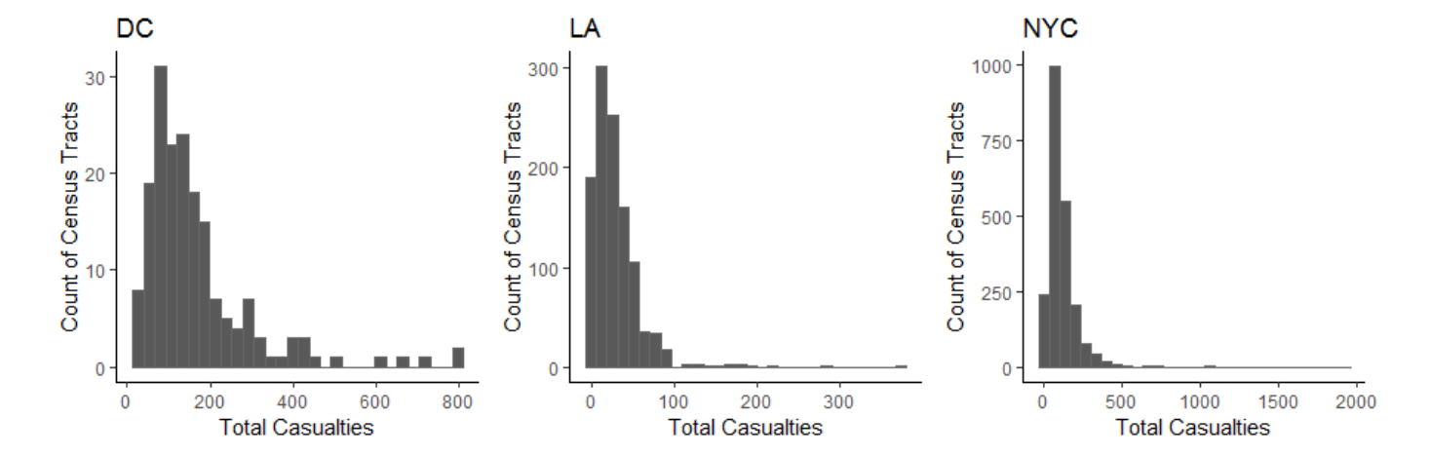
Target Variable : Casualties (injuries + deaths)
A handful of Census Tracts contain a large number of casualties

Slide 17
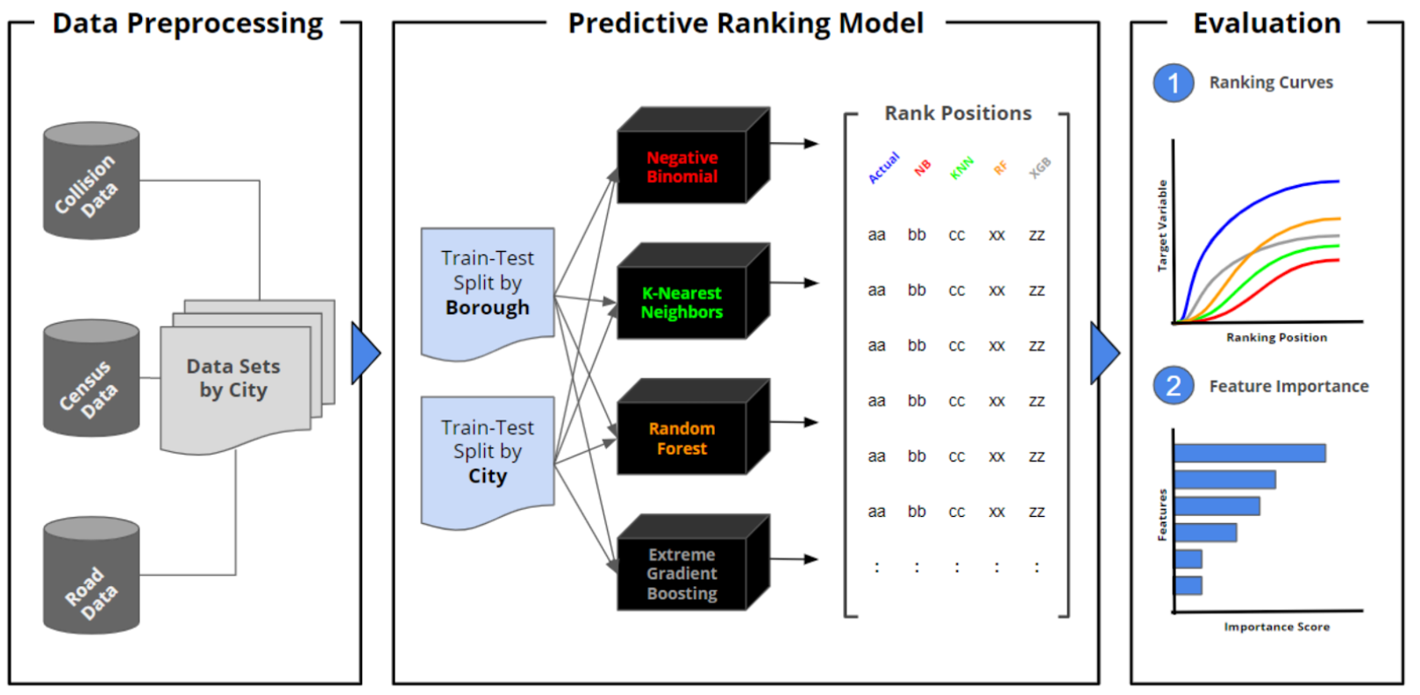

Slide 18
Where does a city new to Vision Zero allocate resources?
We intend to predict the ranking of census tracts in a city from highest to lowest casualties over a five year period.
With this ranking, city officials can make more informed decisions about where to prioritize resources, and learn about the informativeness of the variables that produce it.

Slide 19
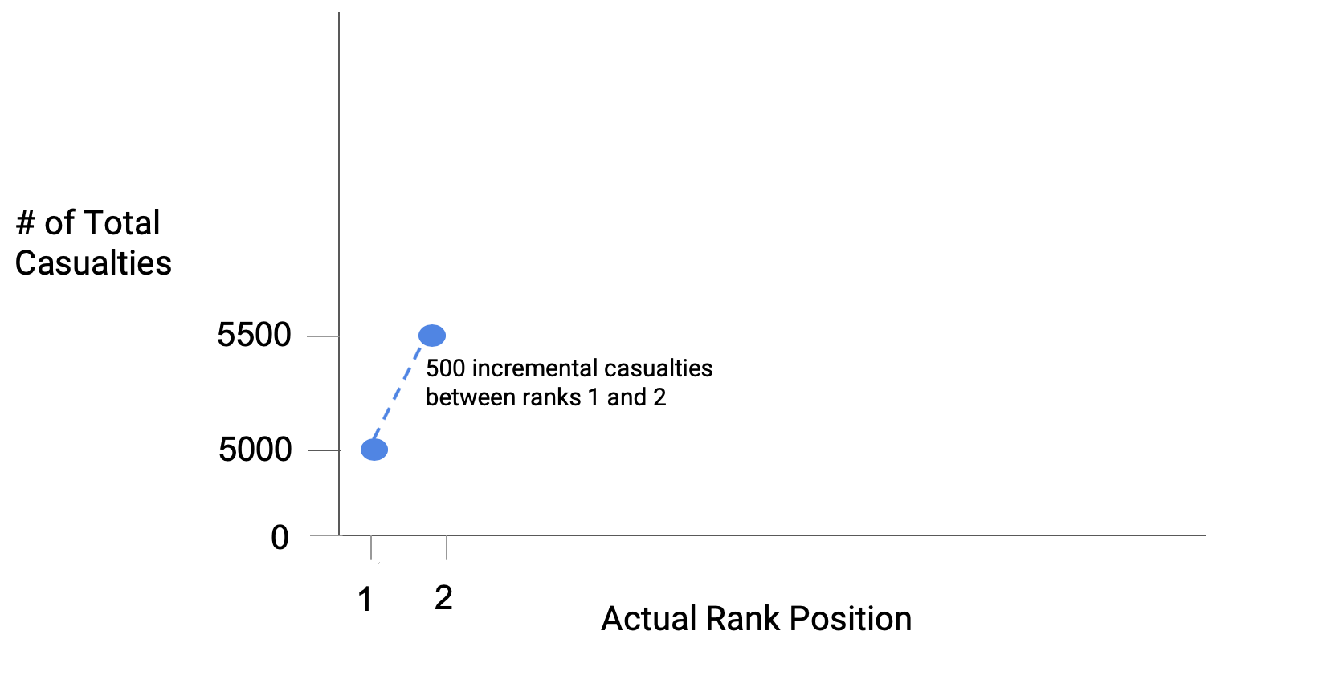
We started with what a perfect ranking would be

Slide 20
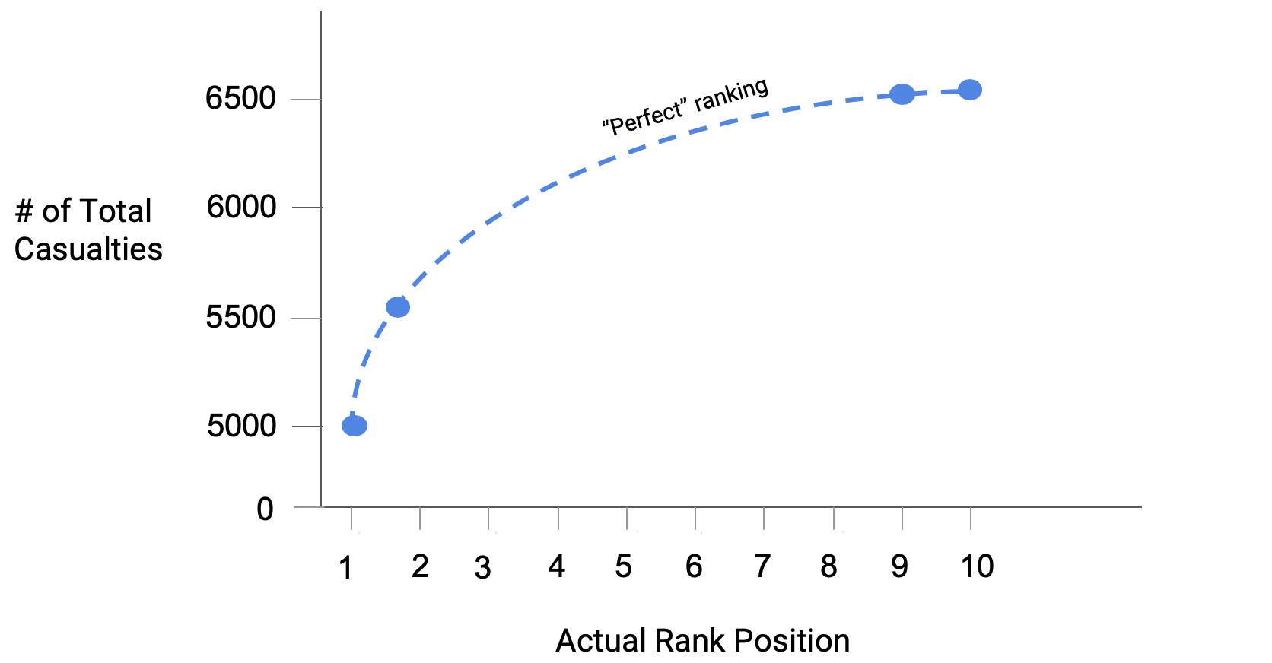
We started with what a perfect ranking would be

Slide 21
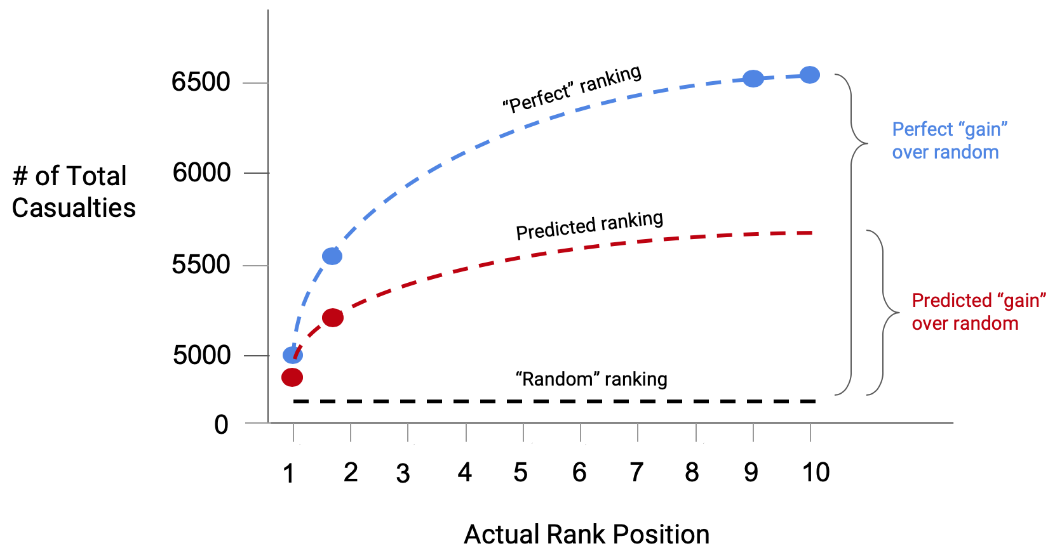
Compare a perfect ranking to our predicted one

Slide 22
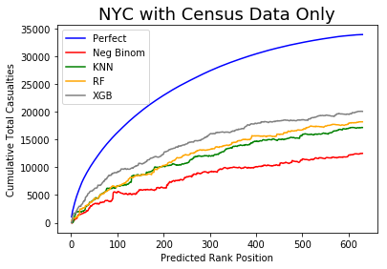
Using solely a city’s Census data, we can predict the ranking of census tract casualties better than random chance
1

Slide 23
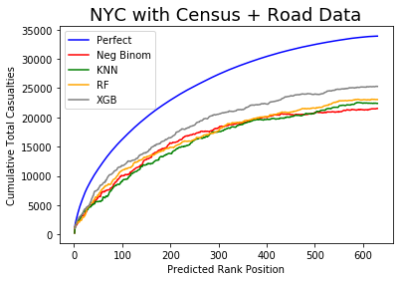
Using a city’s Census data and road characteristics, we can predict the ranking of census tract casualties better than if we had used Census data alone
2

Slide 24
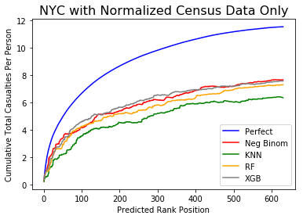
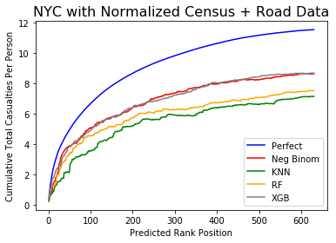
Using a city’s Census data and road characteristics, we can predict the ranking of census tract casualties better than if we had used Census data alone
2
When controlling for population...
...the performance remains better than random chance

Slide 25
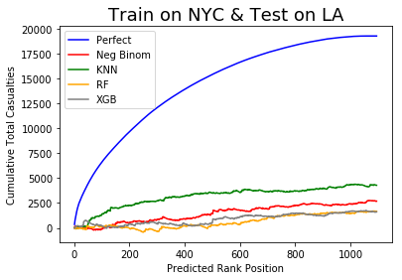
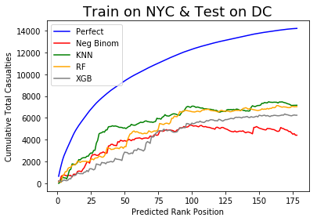
We can predict the ranking of census tract casualties by applying the model built on one city to another city and achieve results better than random
3

Slide 26
If Census data are useful in predicting casualty rankings — within the same city and across different cities — which variables drive these results?

Slide 27
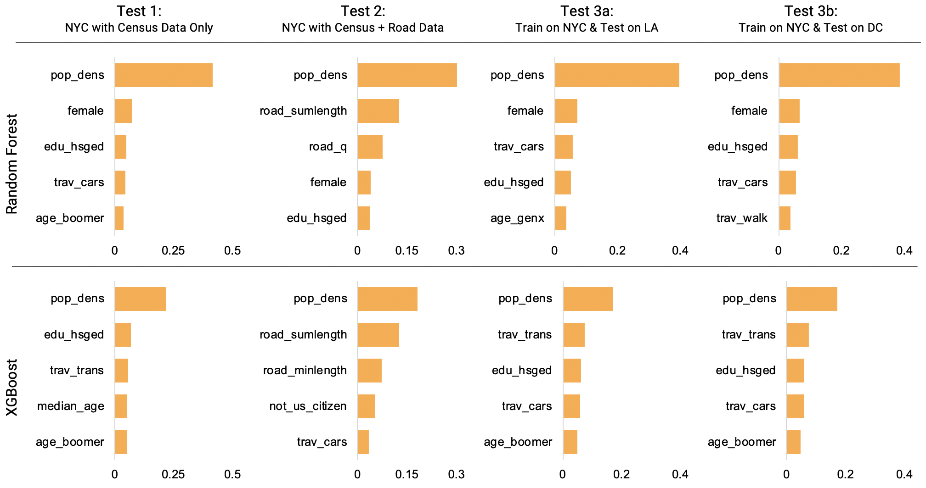
We can look at how important each variable is to the ranking prediction
Top 5 Features

Slide 28
Population density is consistently the most important feature
Top 5 Features

Slide 29
Primary Objective
Where does a city new to Vision Zero allocate resources?
Secondary Objective
How can Vision Zero cities better learn from each other?

Slide 30
We handpicked features and applied ordinary least squares (OLS) regression to explore relationships between them and casualties per person
Dependent Variables
Explanatory Variables
Log casualties per person
Log population density
Median age
Median earnings
% commute via public transit
% commute via driving
% commute via walking
% commute via biking

Slide 31
Population density has statistically significant negative relationship with casualties
1
DV: Log Casualties Per Person | NYC Adj. R² = 0.34 |  |  | LA Adj. R² = 0.13 |  |  | DC Adj. R² = 0.19
IV | Coef. | Std. Error | P- Value | Coef. | Std. Error | P- Value | Coef. | Std. Error | P- Value
Intercept | 4.805 | 0.291 | 0.000 | -3.279 | 0.573 | 0.000 | 0.241 | 0.981 | 0.807
Log Pop. Density | -0.777 | 0.024 | 0.000 | -0.204 | 0.051 | 0.000 | -0.453 | 0.093 | 0.000
Median Age | -0.009 | 0.003 | 0.001 | -0.007 | 0.007 | 0.276 | 0.036 | 0.012 | 0.002
Median Earnings | 0.000 | 0.000 | 0.000 | 0.000 | 0.000 | 0.371 | 0.000 | 0.000 | 0.013
% Drive to Work | -2.275 | 0.275 | 0.000 | -0.418 | 0.436 | 0.338 | -2.326 | 0.988 | 0.020
% Bus / Train to Work | 1.840 | 0.211 | 0.000 | 6.465 | 0.821 | 0.000 | 1.128 | 0.809 | 0.134
% Bike to Work | -2.574 | 1.796 | 0.152 | 9.595 | 3.513 | 0.006 | 3.160 | 2.501 | 0.208
% Walk to Work | 3.470 | 0.410 | 0.000 | 6.089 | 1.362 | 0.000 | 2.270 | 0.781 | 0.004

Slide 32
Across all cities, the percent traveling to work via walking or biking has a positive relationship to casualties per person, while the percent commuting to work via cars has a negative relationship
2
DV: Log Casualties Per Person | NYC Adj. R² = 0.34 |  |  | LA Adj. R² = 0.13 |  |  | DC Adj. R² = 0.19
IV | Coef. | Std. Error | P- Value | Coef. | Std. Error | P- Value | Coef. | Std. Error | P- Value
Intercept | 4.805 | 0.291 | 0.000 | -3.279 | 0.573 | 0.000 | 0.241 | 0.981 | 0.807
Log Pop. Density | -0.777 | 0.024 | 0.000 | -0.204 | 0.051 | 0.000 | -0.453 | 0.093 | 0.000
Median Age | -0.009 | 0.003 | 0.001 | -0.007 | 0.007 | 0.276 | 0.036 | 0.012 | 0.002
Median Earnings | 0.000 | 0.000 | 0.000 | 0.000 | 0.000 | 0.371 | 0.000 | 0.000 | 0.013
% Drive to Work | -2.275 | 0.275 | 0.000 | -0.418 | 0.436 | 0.338 | -2.326 | 0.988 | 0.020
% Bus / Train to Work | 1.840 | 0.211 | 0.000 | 6.465 | 0.821 | 0.000 | 1.128 | 0.809 | 0.134
% Bike to Work | -2.574 | 1.796 | 0.152 | 9.595 | 3.513 | 0.006 | 3.160 | 2.501 | 0.208
% Walk to Work | 3.470 | 0.410 | 0.000 | 6.089 | 1.362 | 0.000 | 2.270 | 0.781 | 0.004

Slide 33
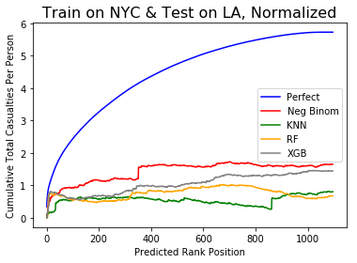
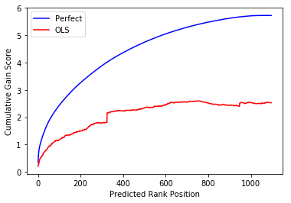
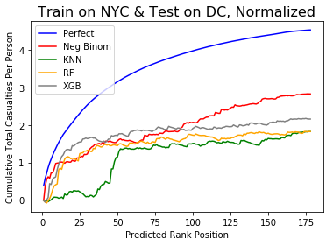
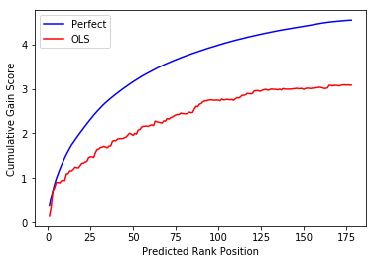
Our handpicked variables produced rankings just as well, if not better, than ML predicted rankings
3
ML Predicted
OLS Regression
Los Angeles
Washington
D.C.

Slide 34
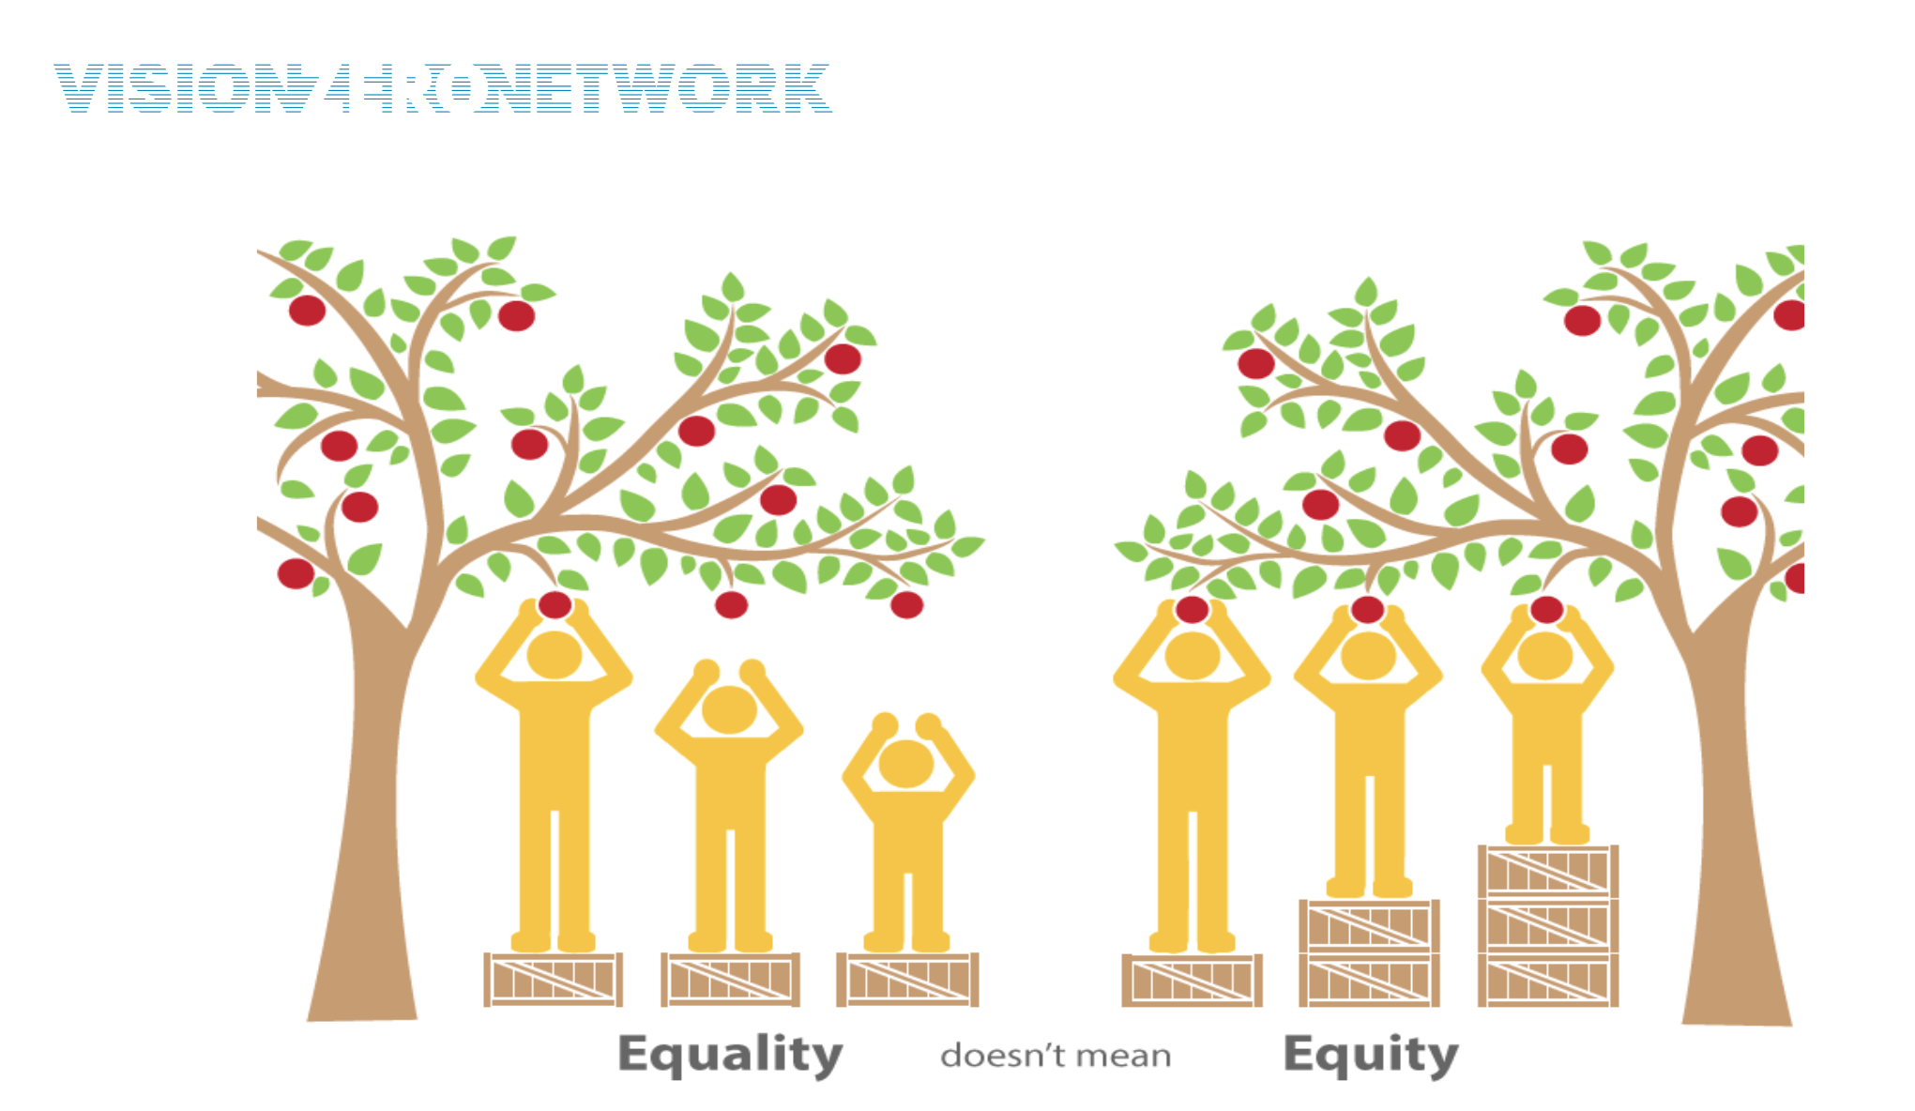
Ethical Considerations
“Elevating equity in Visio Zero communications, Nov 2016”

Slide 35
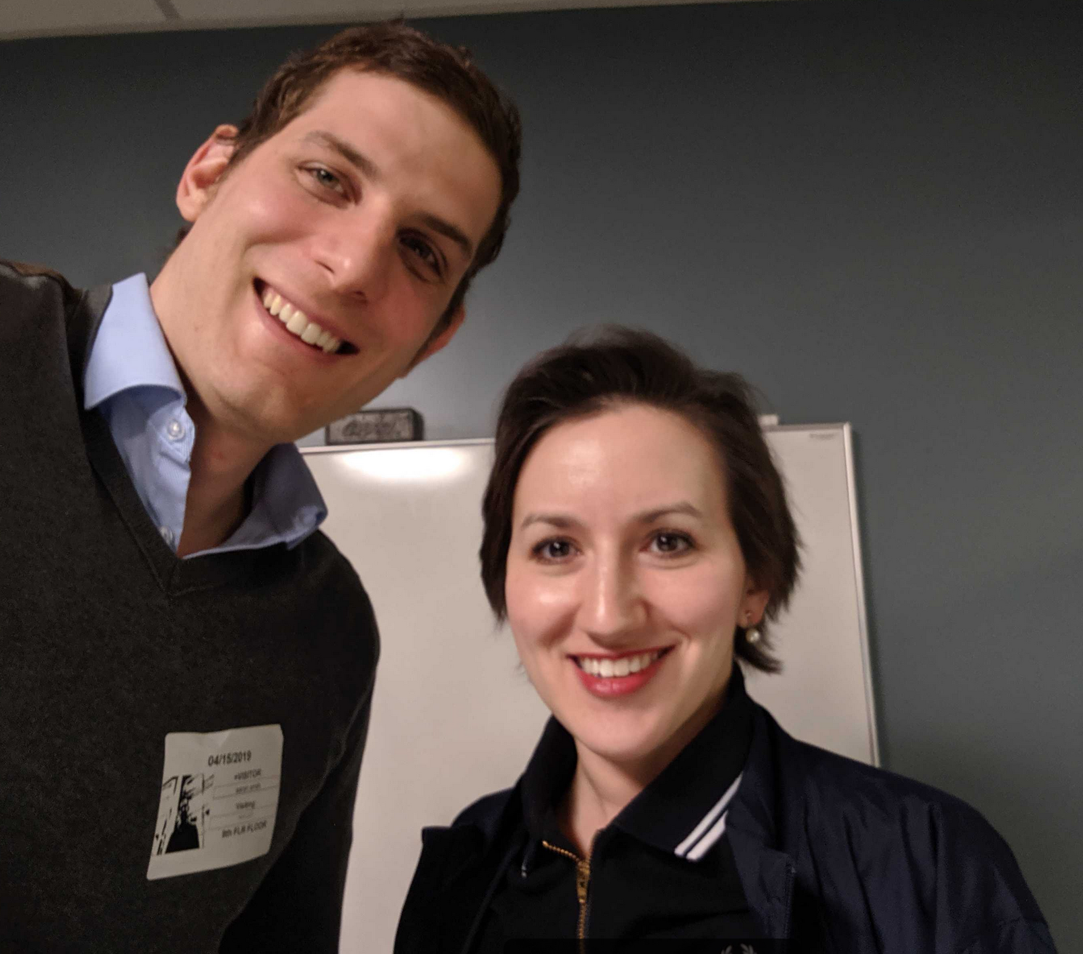
Recommendations for
Vision Zero

Slide 36
Top 3 Takeaways
Vision Zero can use our ranking method to prioritize traffic resources in the absence of robust data, or compare their actual ranking with our predicted ranking to inform proactive interventions
1
2
Vision Zero should consider socio-economic characteristics when crafting safety strategies, as Census data can predict the ranking of casualties better than random chance
3
Vision Zero cities should work together to examine “commuter town” Census Tracts, sparse areas where there is competing land usage

Slide 37
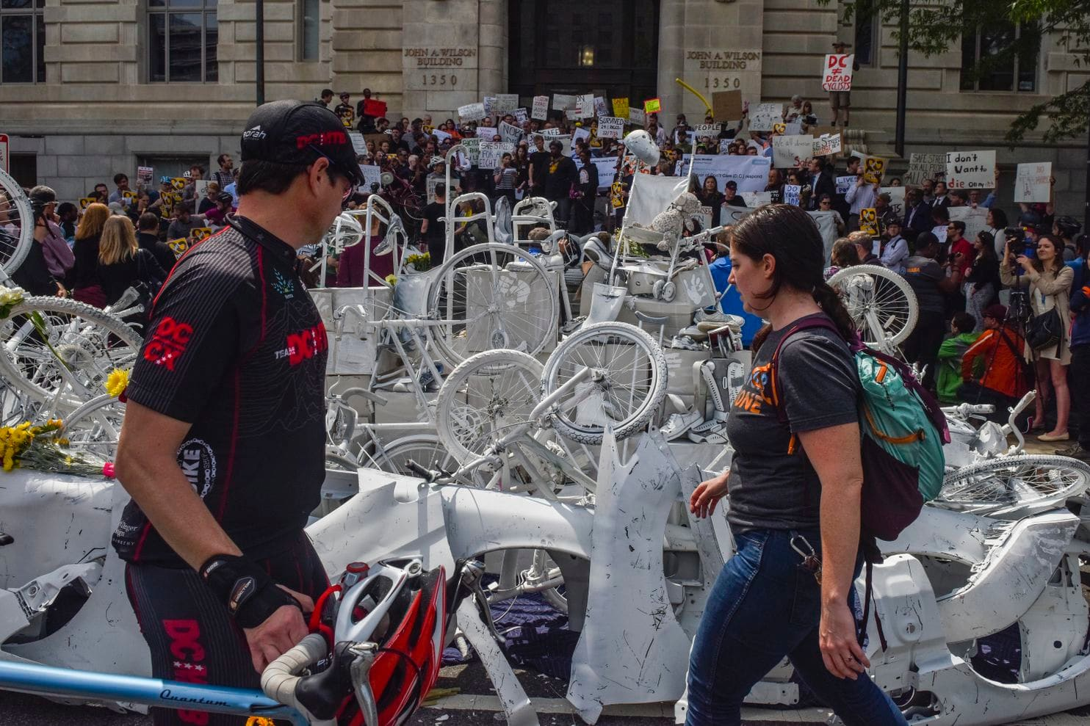

April 26, 2019 - Pennsylvania Ave Washington D.C.

Slide 38
April 26, 2019 - Pennsylvania Ave Washington D.C.
“We understand you, and we will take bold action to work towards Vision Zero. We are going to do better. We can, we should, and we will.”
-Lucinda Babers, Department of Transportation

Slide 39





Team Knight Rider
Noah Branham
David Huang
Tamara Kempf
Michael Marra
Aaron Smith

Slide 40
APPENDIX

Slide 41
Summary of Collision Data per City or Borough
City | Borough | 2017 Population | 2013-2017 Collisions | 2013-2017 Injuries | 2013-2017 Deaths
New York | Manhattan | 1.7M | 211K | 38K | 182
 | Bronx | 1.5M | 119K | 35K | 149
 | Queens | 2.4M | 250K | 66K | 326
 | Brooklyn | 2.7M | 263K | 76K | 300
Washington D.C. | D.C. | 700K | 11K | 30K | 108
Los Angeles | LA | 4M | 176K | 31K | 686

Slide 42
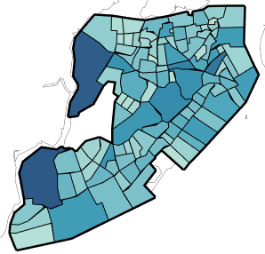
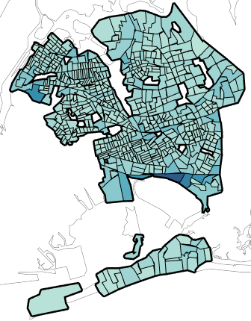
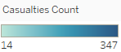
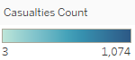
Staten Island Casualties Per Census Tract
Queens Casualties Per Census Tract

Slide 43
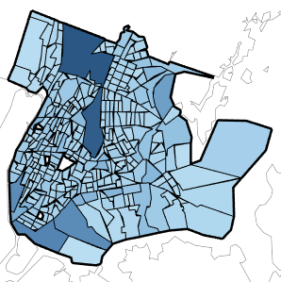
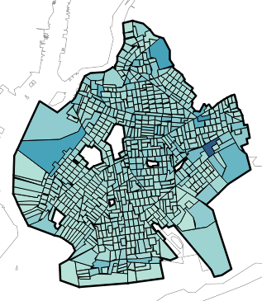
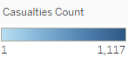
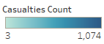
Bronx Casualties Per Census Tract
Brooklyn Casualties Per Census Tract

Slide 44
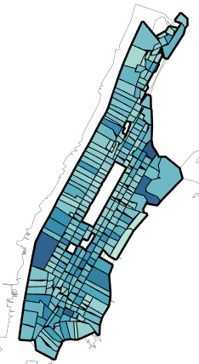
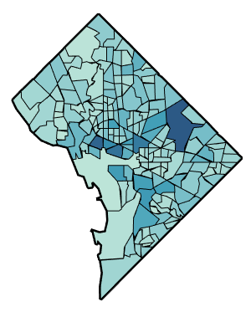
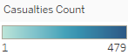
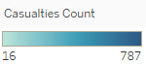
Manhattan Casualties Per Census Tract
DC Casualties Per Census Tract

Slide 45
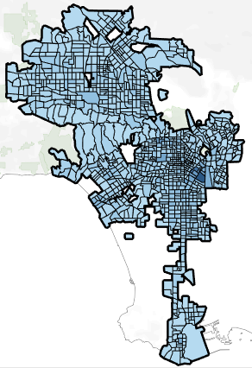
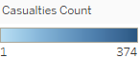
LA Casualties Per Census Tract

Slide 46
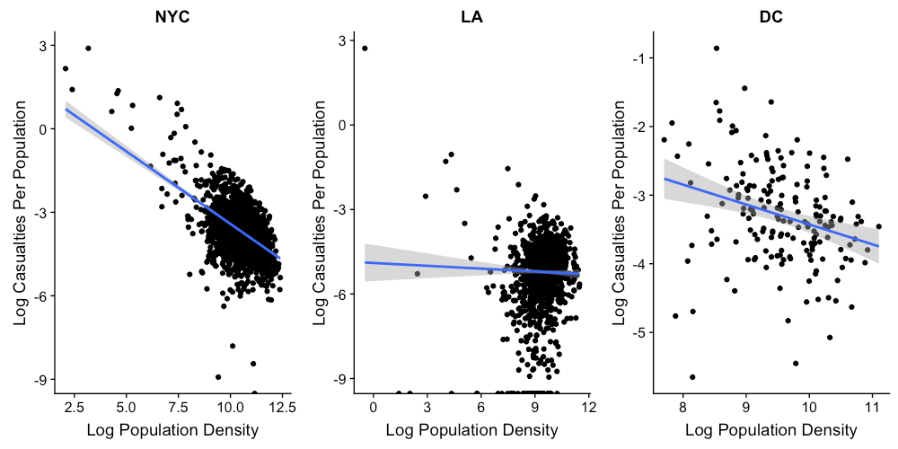
Log Casualties Per Person vs. Log Population Density

Slide 47
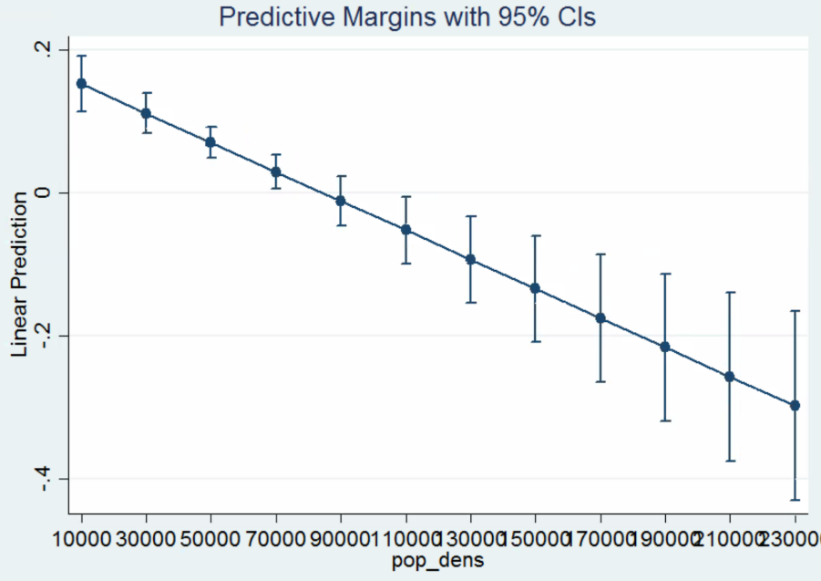
Marginal Change in Expected Impact on Casualties Per Person Given Changes to Population Density
Linear Regression Predictive Margins with 95% CI
0.2
0
Expected impact on Casualties
Per Person
-0.2
-0.4
10
30
50
70
90
110
130
150
170
190
210
230
Population Density (000)

Slide 48
Cross City OLS Regression Results (Without Interaction Variable)
DV: Log Casualties Per Person | NYC Adj. R² = 0.49 |  |  | LA Adj. R² = 0.17 |  |  | DC Adj. R² = 0.18
IV | Coef. | Std. Error | P- Value | Coef. | Std. Error | P- Value | Coef. | Std. Error | P- Value
Intercept | 5.745 | 0.243 | 0.000 | -3.028 | 0.552 | 0.000 | 0.631 | 0.975 | 0.518
Log Pop. Density | -0.820 | 0.019 | 0.000 | -0.192 | 0.047 | 0.000 | -0.463 | 0.093 | 0.000
Median Age | -0.008 | 0.003 | 0.005 | -0.013 | 0.007 | 0.054 | 0.030 | 0.011 | 0.008
Median Earnings | -0.001 | 0.000 | 0.082 | -0.000 | 0.000 | 0.944 | -0.001 | 0.000 | 0.045
% Drive to Work | -3.856 | 0.254 | 0.000 | -0.738 | 0.424 | 0.082 | -2.831 | 0.918 | 0.002
% Bus / Train to Work | 0.440 | 0.185 | 0.017 | 6.708 | 0.821 | 0.000 | 1.205 | 0.792 | 0.130
% Walk * Bike to Work | 29.540 | 10.702 | 0.006 | 164.521 | 24.017 | 0.000 | 53.793 | 18.387 | 0.004

Slide 49
NYC Cross Borough OLS Regression Results
DV: Log Casualties Per Person | Queens Adj. R² = 0.60 |  |  | Bronx Adj. R² = 0.68 |  |  | Brooklyn Adj. R² = 0.51
IV | Coef. | Std. Error | P- Value | Coef. | Std. Error | P- Value | Coef. | Std. Error | P- Value
Intercept | 3.162 | 0.524 | 0.000 | 3.914 | 0.574 | 0.000 | 3.565 | 0.519 | 0.000
Log Pop. Density | -0.823 | 0.038 | 0.000 | -0.774 | 0.037 | 0.000 | -0.783 | 0.038 | 0.000
Median Age | 0.000 | 0.005 | 0.916 | -0.006 | 0.008 | 0.464 | -0.012 | 0.005 | 0.009
Median Earnings | -0.000 | 0.000 | 0.003 | -0.000 | 0.000 | 0.000 | -0.000 | 0.000 | 0.400
% Drive to Work | -0.932 | 0.502 | 0.064 | -0.346 | 0.672 | 0.607 | -2.725 | 0.498 | 0.000
% Bus / Train to Work | 2.119 | 0.387 | 0.000 | 0.883 | 0.554 | 0.112 | 0.562 | 0.300 | 0.062
Max Speed Limit | -0.001 | 0.002 | 0.625 | -0.003 | 0.003 | 0.405 | -0.011 | 0.003 | 0.001
Max Number of Lanes | 0.035 | 0.019 | 0.066 | -0.026 | 0.027 | 0.339 | 0.036 | 0.025 | 0.142
Annual Avg. Daily Traffic | 0.138 | 0.022 | 0.000 | 0.122 | 0.029 | 0.000 | 0.192 | 0.026 | 0.000
% Minority Race | 0.651 | 0.121 | 0.000 | 0.635 | 0.244 | 0.010 | 0.725 | 0.086 | 0.000
% Walk * Bike to Work | 3.162 | 0.524 | 0.924 | -132.01 | 231.723 | 0.569 | -4.805 | 37.426 | 0.898

Slide 50
Summary Statistics of Selected Features
Summary Stats | NYC (n = 1954) |  |  |  | LA (n = 1097) |  |  |  | DC (n = 178)
Variables | Mean | SD | Min | Max | Mean | SD | Min | Max | Mean | SD | Min | Max
Casualties Per Pop. | 0.06 | 0.49 | 0.00 | 18.02 | 0.02 | 0.46 | 0.00 | 15.20 | 0.05 | 0.05 | 0.00 | 0.42
Pop. Density | 53912 | 36383 | 7.96 | 241500 | 16717 | 13520 | 0.62 | 96800 | 17720 | 11983 | 2208 | 66344
Median Age | 36.37 | 6.06 | 12.60 | 65.7 | 36.08 | 6.50 | 17.50 | 68.20 | 34.93 | 6.08 | 19.70 | 50.20
Median Earnings ($K) | 38.46 | 18.62 | 3.06 | 155.03 | 32.58 | 16.25 | 25.55 | 101.53 | 48.05 | 21.71 | 25.00 | 110.87
% Drive to Work | 0.13 | 0.08 | 0.00 | 0.54 | 0.37 | 0.09 | 0.02 | 0.65 | 0.21 | 0.07 | 0.01 | 0.37
% Bus / Train to Work | 0.27 | 0.10 | 0.00 | 0.80 | 0.05 | 0.05 | 0.00 | 0.41 | 0.19 | 0.08 | 0.001 | 0.41
% Bike to Work | 0.01 | 0.01 | 0.00 | 0.10 | 0.01 | 0.01 | 0.00 | 0.20 | 0.02 | 0.02 | 0.00 | 0.15
% Walk to Work | 0.04 | 0.05 | 0.00 | 0.66 | 0.02 | 0.02 | 0.00 | 0.28 | 0.07 | 0.09 | 0.00 | 0.38
% Below Poverty Line | 0.19 | 0.13 | 0.00 | 0.75 | 0.21 | 0.13 | 0.00 | 0.81 | 0.18 | 0.12 | 0.01 | 0.63
Max Speed Limit | 20.11 | 14.23 | 0.00 | 55 | n/a | n/a | n/a | n/a | n/a | n/a | n/a | n/a
Max Number of Lanes | 2.04 | 1.55 | 0.09 | 10.00 | n/a | n/a | n/a | n/a | n/a | n/a | n/a | n/a
Annual Avg. Daily Traffic | 6485 | 10690 | 0.20 | 118413 | n/a | n/a | n/a | n/a | n/a | n/a | n/a | n/a
Road Quality Index | 25.67 | 1.97 | 17.65 | 30.34 | n/a | n/a | n/a | n/a | n/a | n/a | n/a | n/a
Pavement Width | 4.23 | 3.86 | 0.01 | 36.32 | n/a | n/a | n/a | n/a | n/a | n/a | n/a | n/a

Slide 51
Correlation Matrix of Selected Features
Selected Features | Log Casualties Per Pop. | Log Population Density | Median Age | Median Earnings | % Drive to Work | % Bus / Train to Work | Max Speed Limit | Max Lanes | Log Annual Avg. Daily Traffic
Log Population Density | -0.595 | 1.000
Median Age | -0.023 | -0.236 | 1.000
Median Earnings | 0.056 | -0.077 | 0.357 | 1.000
% Drive to Work | 0.033 | -0.553 | 0.398 | -0.044 | 1.000
% Bus / Train to Work | -0.006 | 0.317 | -0.100 | 0.255 | -0.552 | 1.000
Max Speed Limit | 0.292 | -0.337 | 0.079 | 0.065 | 0.125 | -0.109 | 1.000
Max Lanes | 0.247 | -0.234 | 0.100 | 0.136 | 0.033 | -0.022 | 0.686 | 1.000
Log Annual Avg. Daily Traffic | 0.341 | -0.246 | 0.039 | 0.102 | 0.024 | -0.056 | 0.732 | 0.557 | 1.000
% Walk * Bike to Work | 0.107 | 0.033 | -0.028 | 0.342 | -0.233 | 0.178 | 0.006 | 0.009 | 0.038

Slide 52
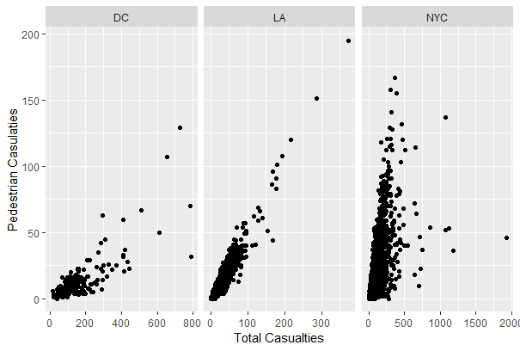
Correlation between
Pedestrian Casualties
and Total Casualties

Slide 53
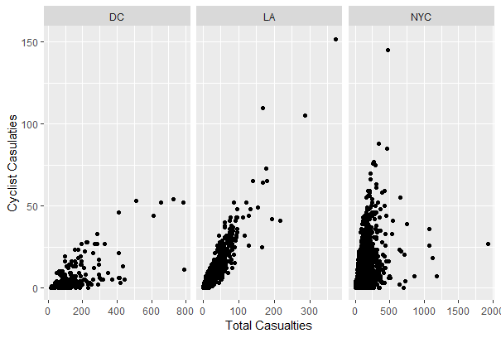
Correlation between
Cyclist Casualties
and Total Casualties

Slide 54
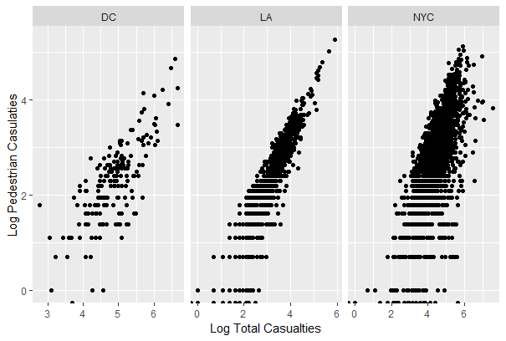
Correlation between
Log Pedestrian Casualties
and Log Total Casualties

Slide 55
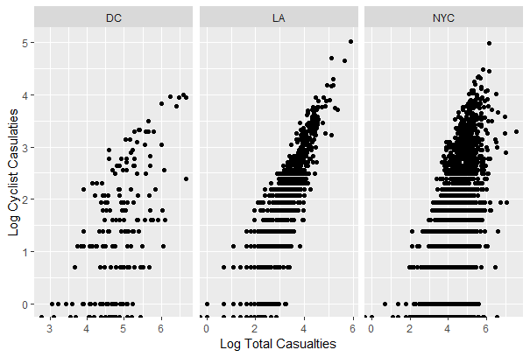
Correlation between
Log Cyclist Casualties
and Log Total Casualties

